Slide 1



Keeping Architectures Relevant
Using DDD and
Emergent Architecture
Brandon Satrom
Paul Rayner
AGILITY. CRAFT. ARCHITECTURE.
Notes:
Image of arrow on the mark

Slide 2
Bio/ Contact Slide

Slide 3
Intro
Notes:
Just a divider

Slide 4
You are the technical Leadership

Slide 5
And yet, Do you ever feel disconnected?

Slide 6
Or Irrelevant?

Slide 7
Or Underappreciated?

Slide 8
how do you spend your time?
Notes:
Quick Hit Slides follow (no more than half a second per)

Slide 9
Meetings

Slide 10
Design

Slide 11
Meetings

Slide 12
Modeling

Slide 13
Meetings

Slide 14
Documentation

Slide 15
Specification

Slide 16
Meetings

Slide 17
Framework Creation

Slide 18
Meta-Framework Creation

Slide 19
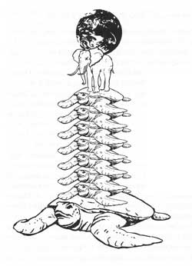
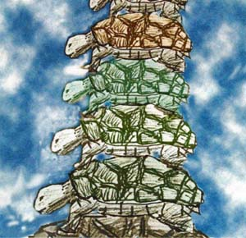
Meta-Meta-Framework Creation
Notes:
http://tatfoundation.org/forum2008-05.htm
http://www.arn.org/blogs/index.php/literature/2009/04/01/philosophy_101_for_the_new_atheists

Slide 20
Meetings

Slide 21
Are those things preventing…

Slide 22
Project Failures

Slide 23
Day One Legacy

Slide 24
Or Addressing…

Slide 25
Complexity
Notes:
Business Domain Complexity Curve Slide (Paul’s graphic idea)

Slide 26
And Enabling…

Slide 27
Delighted Customers

Slide 28
Working Software

Slide 29
We aren’t the only cause of Failure

Slide 30
But Maybe We can be part of a better solution

Slide 31
By Changing Our Focus
Notes:
The right interactions, the right deliverables and the right decisions

Slide 32
Focus On
Notes:
Using Domain-Driven Design and Emergent Architecture, we can keep ourselves and our Architectures Relevant and Connected to the domain. So we focus on:
Creating a Ubiquitous Language
Leading Relevant Modeling
Embracing Emergent Architecture

Slide 33
Ubiquitous Language

Slide 34
Relevant Models

Slide 35
Emergent Architecture

Slide 37
Ubiquitous Language
Notes:
Just a divider

Slide 39
Relevant Models
Notes:
Just a divider

Slide 41
Emergent Architecture
Notes:
Just a divider

Slide 43
Encapsulate, Don’t Coddle
Notes:
Just a divider

Slide 44
Developers don’t own the code they create…
Notes:
This is called collective code ownership… reference?

Slide 45
… so do architects own the designs that they craft?
Notes:
We believe in collective architecture ownership

Slide 46
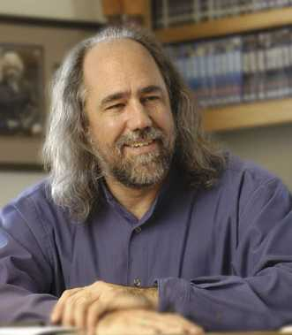
Architecture is a Shared Hallucination
http://domino.research.ibm.com/library/cyberdig.nsf/papers/964EFC48D32D5B2D852576A9004F5289/$File/rc24924.pdf
Notes:
Grady Booch

Slide 47
Design with Evolution in Mind
Notes:
Just a divider

Slide 49
Conclusion
Notes:
Just a divider

Slide 50
Questions?

Slide 51
Contact Us
Paul Rayer: paul@virtual-genius.com :: www.virtual-genius.com/blog
Brandon Satrom: bsatrom@gmail.com :: www.userinexperience.com

Slide 52
References
Dart and Dartboard Image - http://www.flickr.com/photos/vizzzual-dot-com/2655969483/

